Slide 1
Karma Database Update
Scope Doc
7/22/2019 SDE

Slide 2
DataBase updates
Change the SKU# on the product ID label from C131183900300 to C131183900301
Karma date code need to be setup to automatically change based on system date. (see additional notes below)
In database – remove all SN records PRIOR to serial# J506394
Reason: Nu-Way has captured all the GEN1 serial# information and stored data to network folder. NuWay would like current database to only contain records for GEN2 assemblies
http://ubuntu.nu-way.net/karma/fiskerinput.php needs new default values (see attached scope doc)
http://ubuntu.nu-way.net/karma/fiskerupdateV2.php need new inspection criteria (see attached scope doc)
http://ubuntu.nu-way.net/karma/editrecord.php does not pull up records as it did before and needs to be fixed.
After all work has been completed – NuWay needs an instruction document to correct field names or change default data fields should the database require corrections in the future.

Slide 3
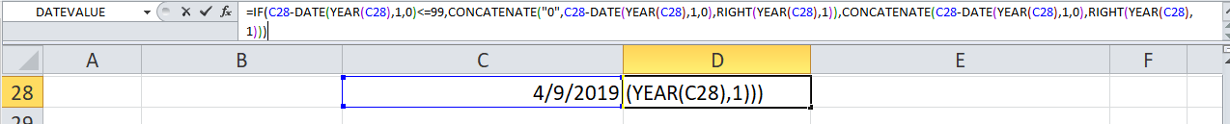
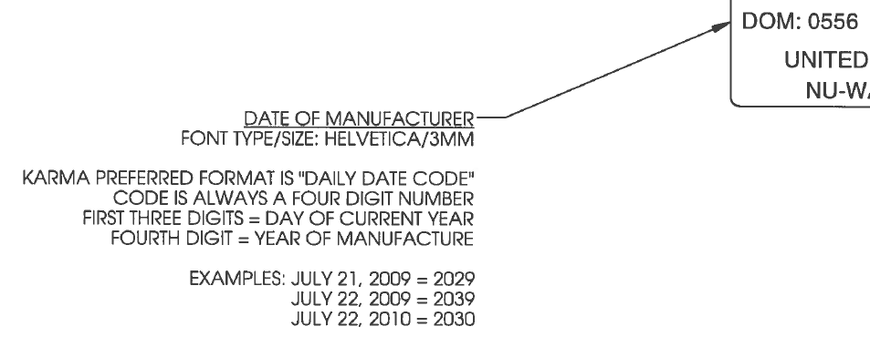
Daily date code - for the printed label needs to be set automaticity - based on system date. Above formula is taken from excel that shows how to concatenate the date code to match Karma requirements below – but it uses a fixed value date –instead of the required system date. (just an example)

Slide 4
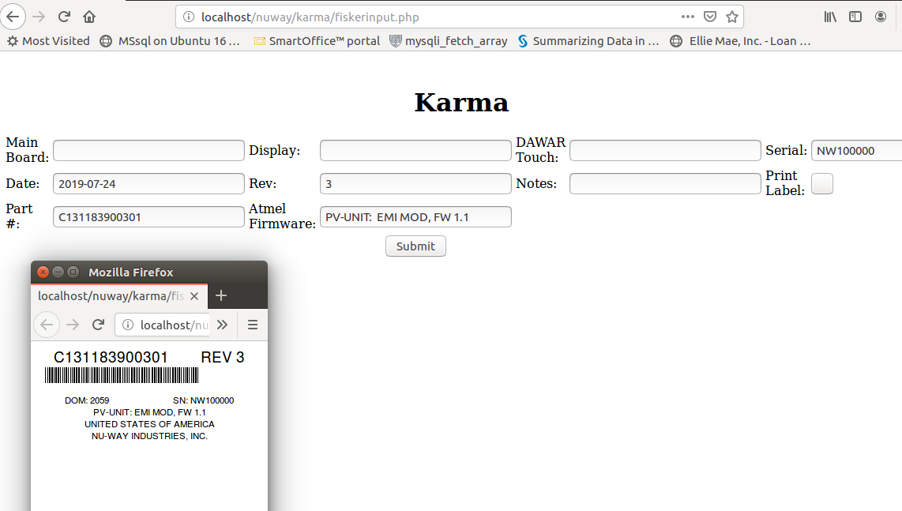
Dom updated to automatically pull in Day and last digit of year.

Slide 5
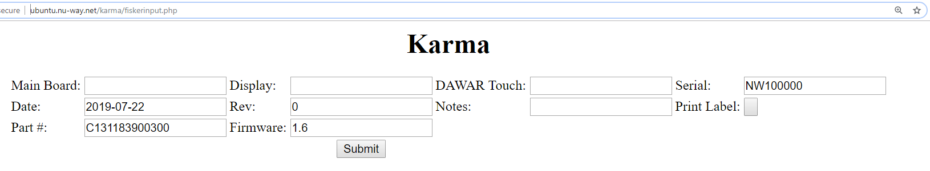
The fields – on this page - need to default to the following values, but still be editiable:
Date = default is system date
Part# = C131183900301
Rev = 0
Firmware = 1.6
Change field to show “Atmel Firmware” – not just “Firmware”
These fields regardless if they have been edited to something different – they ALWAYS resort back to default value when SUMBITTED. This needs to be fixed.
ALL field values on this page (http://ubuntu.nu-way.net/karma/editrecord.php) need to be editable. Not just some fields.

Slide 6
Made changes from Firmware to Amtel Firware (see next slide)

Slide 7
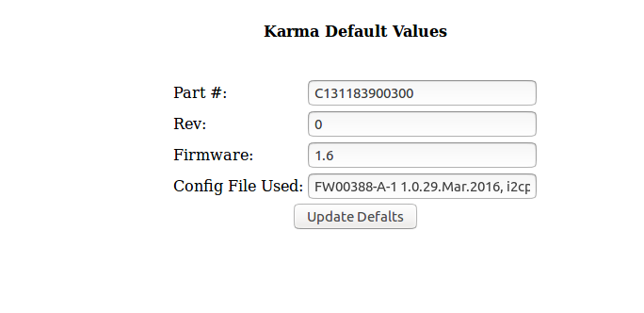
Created new screen and table to hold Default values used to populate App. Make changes and hit update button to save new values.

Slide 8
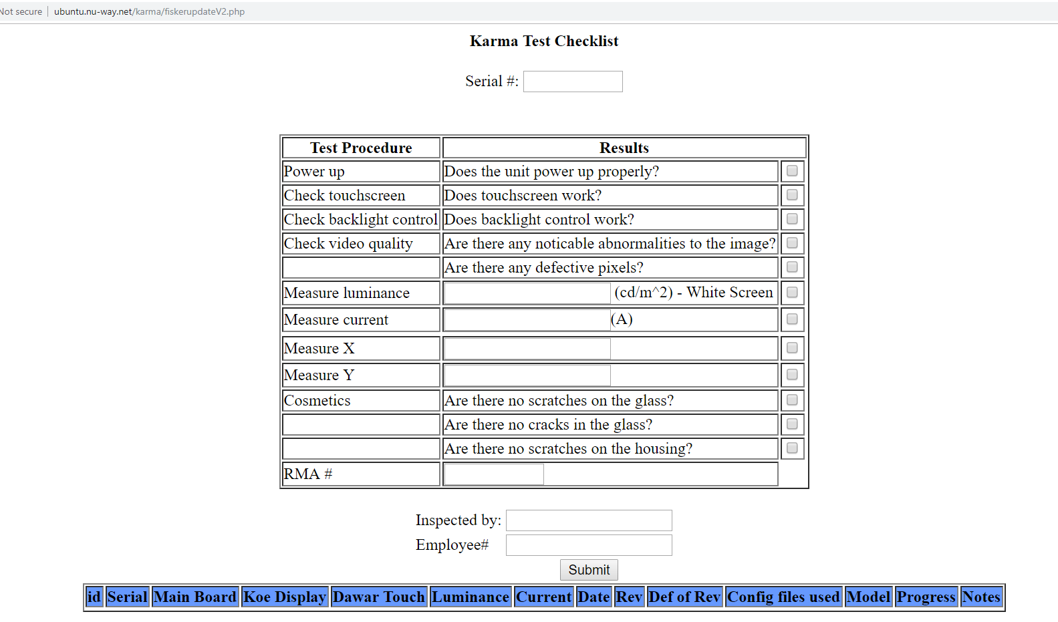
Current Checklist Page – needs to be revised – see following page for changes

Slide 9
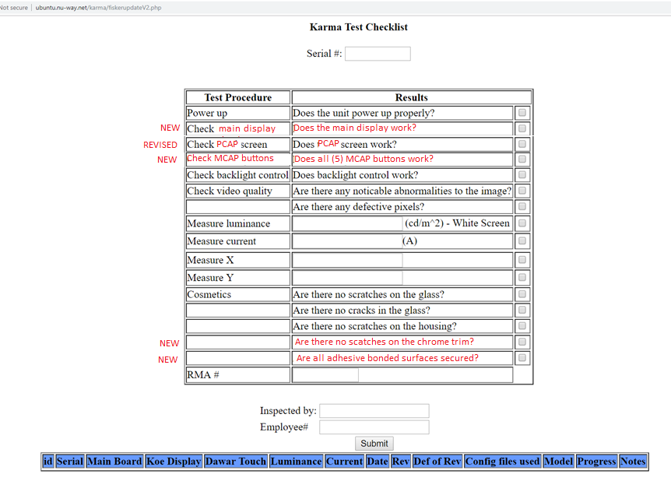
Need (4) new field added to database collection (as shown above)
Need “Check Touchscreen” fields revised with new text (as shown above)

Slide 10
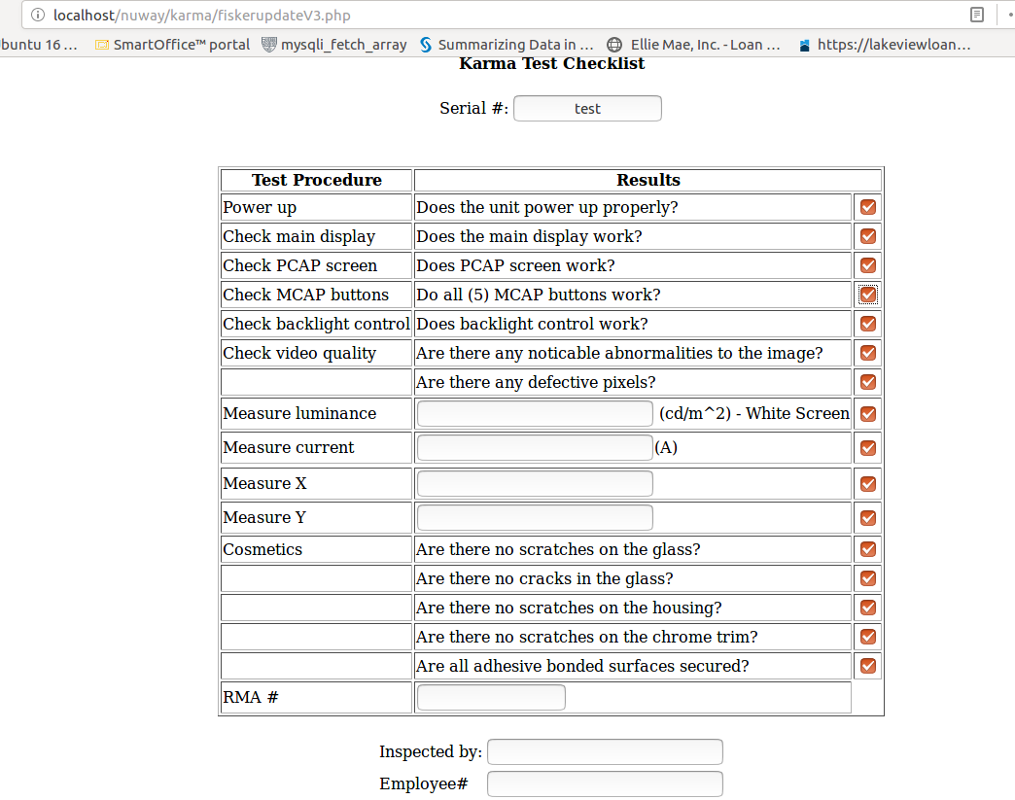
Updated quality check screen to include additional checks

Slide 11
Need the header row - at the top - to be frozen when viewing records. (Similar to freeze panes function in Excel)

Slide 12
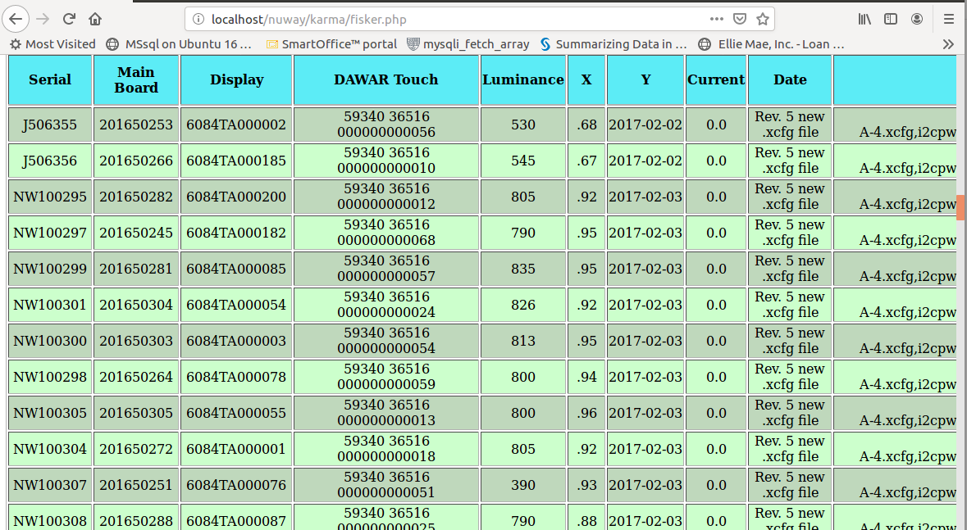
Frozen top fields, see scroll bar to right (half way down screen)

Slide 13
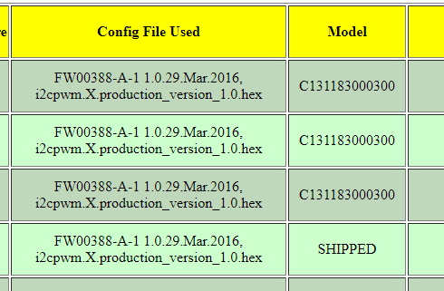
Revise this field name to…
“PCAP Config File / DIM C Hex File Used”
Files names are in flux – ATM – but NW needs to be able to edits the default values later.
Add a new field between here called “MCAP Hex File Used”
Files names are in flux – ATM – but NW needs to be able to edits the default values later.

Slide 14
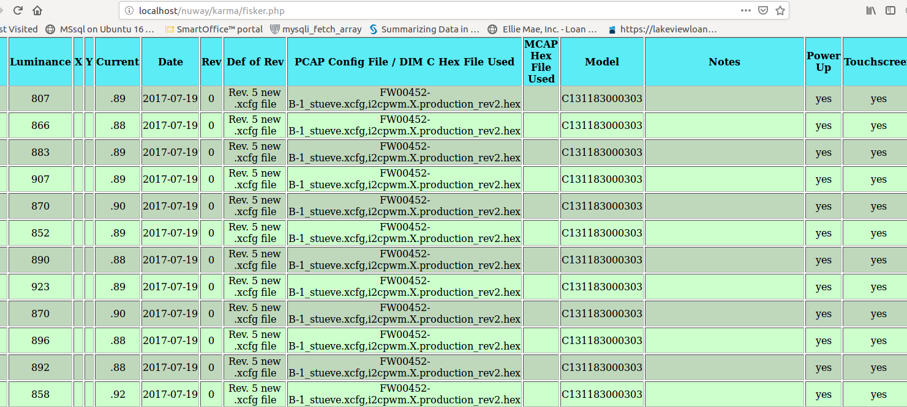
Renamed header and added additional Column but data to be populated was not defined.

Slide 15
Verification with Python
Verify that Python i2c variable setting program interacts properly with updated database (as it was operating under gen1)

